Slide 1
NEW! 2017 Commercial & Industrial Rebate and Incentive Programs
February 2017

Slide 2
This presentation is being provided for informational purposes only and does not purport to be comprehensive. Neither CenterPoint Energy, Inc., together with its subsidiaries and affiliates (the “Company”), nor its employees or representatives, make any representation or warranty (express or implied) relating to this information. By reviewing this presentation, you agree that the Company will not have any liability related to this information or any omissions or misstatements contained herein. You are encouraged to perform your own independent evaluation and analysis.
This presentation contains third party information, including information provided by the various sources identified on the respective slides. CenterPoint Energy, Inc. has not independently verified this information. You are encouraged to perform your own independent evaluation and analysis.

Slide 3
Forward Looking Statements
This presentation and the oral statements made in connection herewith may contain statements concerning our expectations, beliefs, plans, objectives, goals, strategies, future operations, events, financial position, earnings, growth, revenues costs, prospects, objectives, capital investments or performance and underlying assumptions and other statements that are not historical facts. These statements are “forward-looking statements” within the meaning of the Private Securities Litigation Reform Act of 1995. You should not place undue reliance on forward-looking statements. Actual results may differ materially from those expressed or implied by these statements. You can generally identify our forward-looking statements by the words “anticipate,” “believe,” “continue,” “could,” “estimate,” “expect,” “forecast,” “goal,” “project,” “intend,” “may,” “objective,” “plan,” “potential,” “predict,” “projection,” “should,” “will,” or other similar words. The absence of these words, however, does not mean that the statements are not forward-looking.
Forward-looking statements in this presentation include statements about our Conservation Improvement Program rebates, services and incentives. We have based our forward-looking statements on our management's beliefs and assumptions based on information currently available to our management at the time the statements are made. We caution you that assumptions, beliefs, expectations, intentions, and projections about future events may and often do vary materially from actual results. Therefore, we cannot assure you that actual results will not differ materially from those expressed or implied by our forward-looking statements.
Some of the factors that could cause actual results to differ from those expressed or implied by our forward-looking statements include but are not limited to the timing and impact of future regulatory, legislative and IRS decisions, financial market conditions, future market conditions, economic and employment conditions, customer growth and other factors described in CenterPoint Energy, Inc.’s Form 10-K under “Risk Factors” and “Management’s Discussion and Analysis of Financial Condition and Results of Operations - Certain Factors Affecting Future Earnings” and in other filings with the SEC by CenterPoint Energy, which can be found at www.centerpointenergy.com on the Investor Relations page or on the SEC’s website at www.sec.gov.

Slide 4
But first…
A little context on where your utility rebates came from.

Slide 5
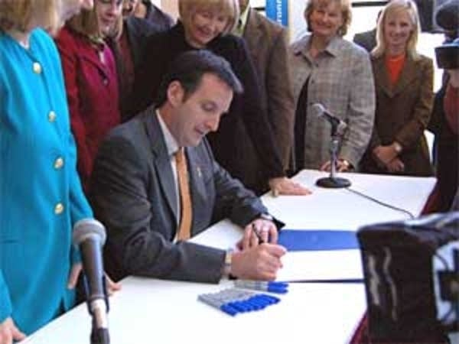
Next Generation Energy Act 2007
Laws of Minnesota, 2007, Ch. 136
(Art. 1, Sec. 2, Subd. 2)
Energy Policy Goals.
It is the policy of the
State of Minnesota that:
  The per capita use of fossil fuel as an energy input be reduced by 15 percent…through increased reliance on energy efficiency and renewable energy alternatives; and
  25% of the total energy used in the state be derived from renewable energy resources by the year 2025.
Pawlenty signs renewable energy bill in 2007.
Tom Scheck / MPR News

Slide 6
Next Generation Energy Act 2007
Article 1: General Provisions
Article 2: Energy Efficiency and Conservation
Article 3: Miscellaneous (education, audits)
Article 4: Community-Based Energy Development
Article 5: Global Climate Change;
Greenhouse Gas Emissions
Article 6: Renewable Energy Standards

Slide 7
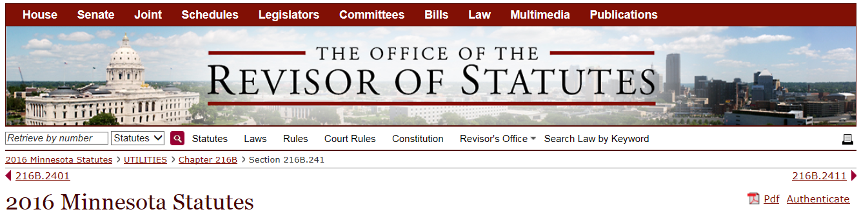
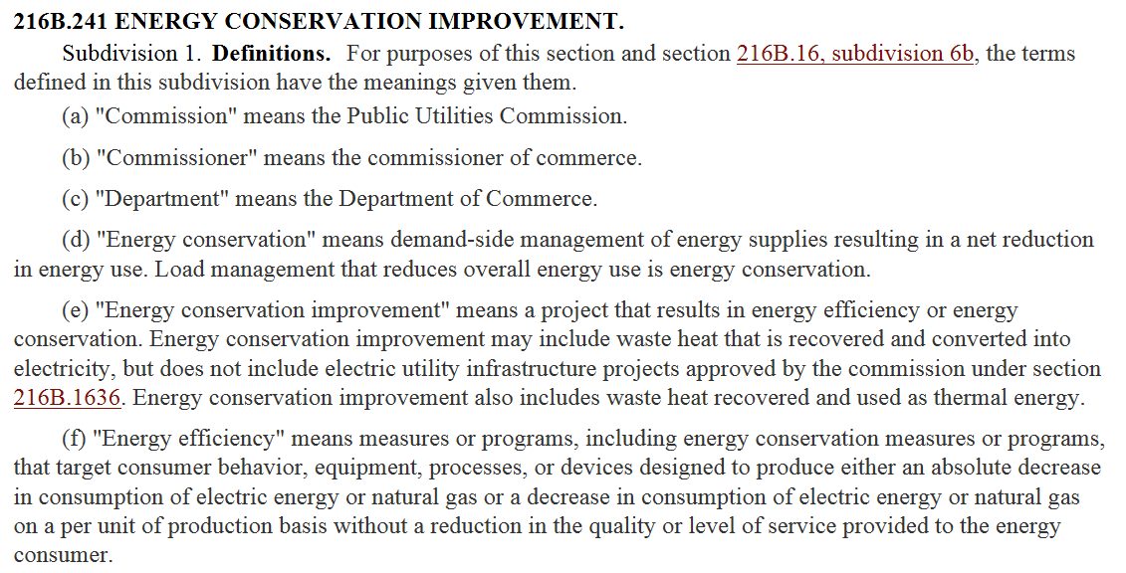
Minnesota Statutes 2016
216B.241 Energy Conservation Improvement

Slide 8
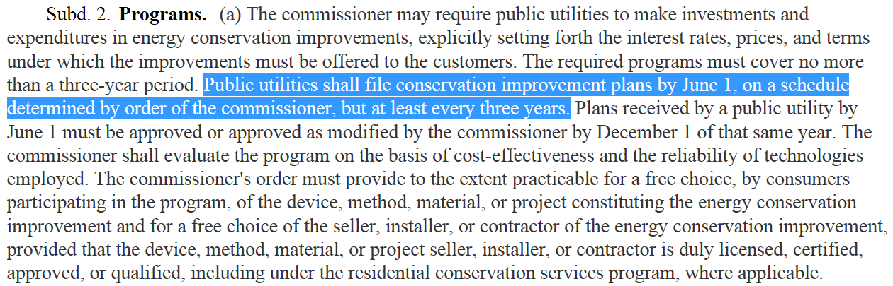
Minnesota Statutes 2016
216B.241 Energy Conservation Improvement

Slide 9
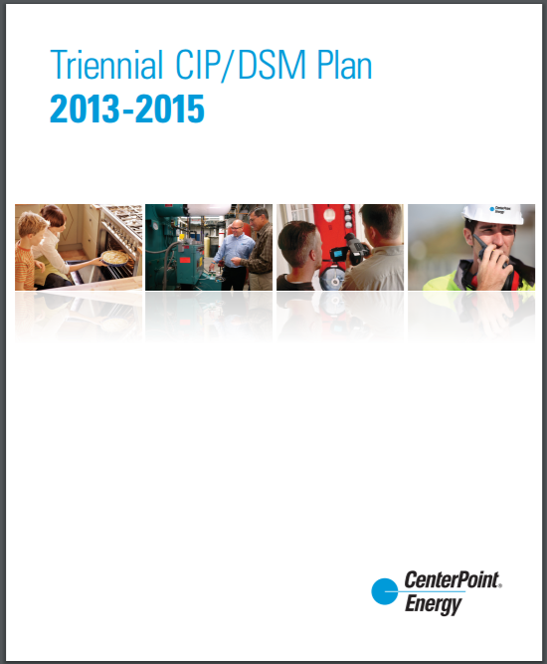
Utility CIP Triennial

Slide 10
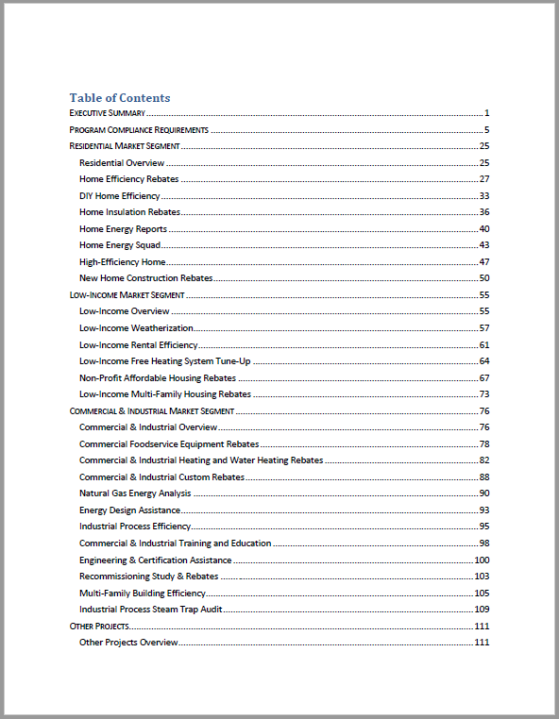
Utility CIP Triennial

Slide 11
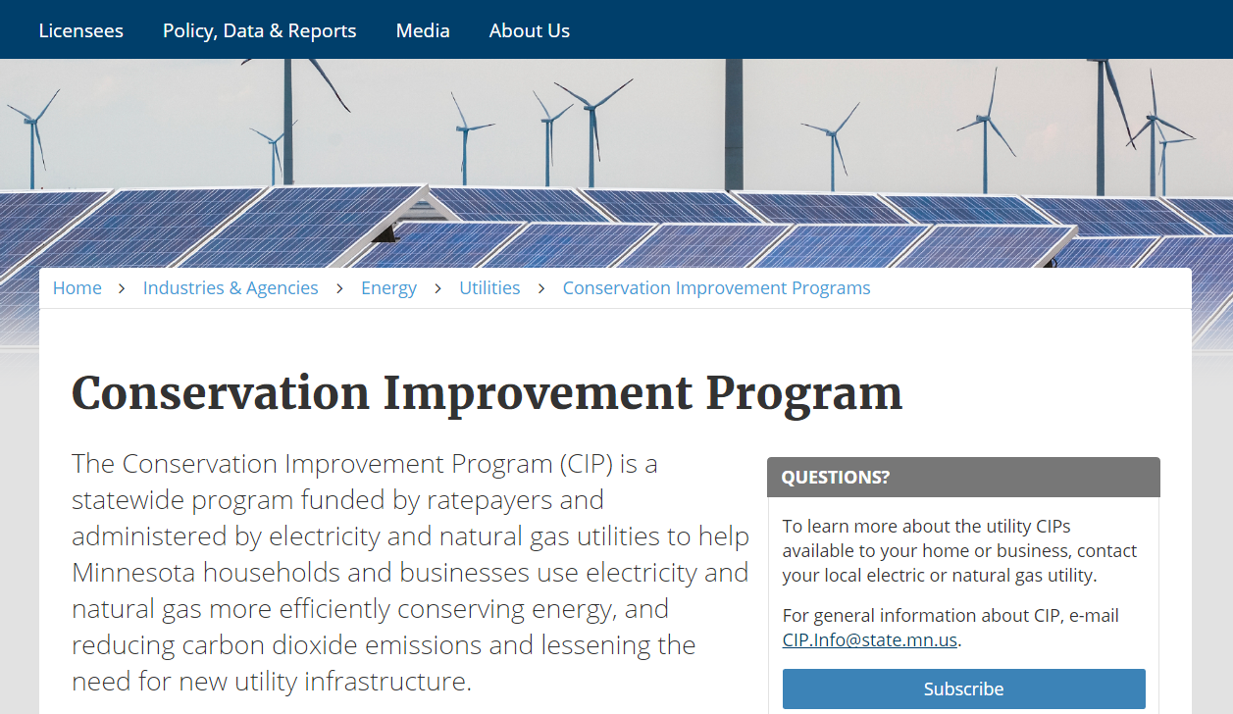
Department of Commerce
Division of Energy Resources

Slide 12

Department of Commerce
Division of Energy Resources
The State provides technical assistance and tools to help utilities identify conservation opportunities, calculate savings, and report program results.
Conservation Applied Research and Development (CARD) program
Technical Reference Manual (TRM)
Energy Savings Platform (ESP)

Slide 13
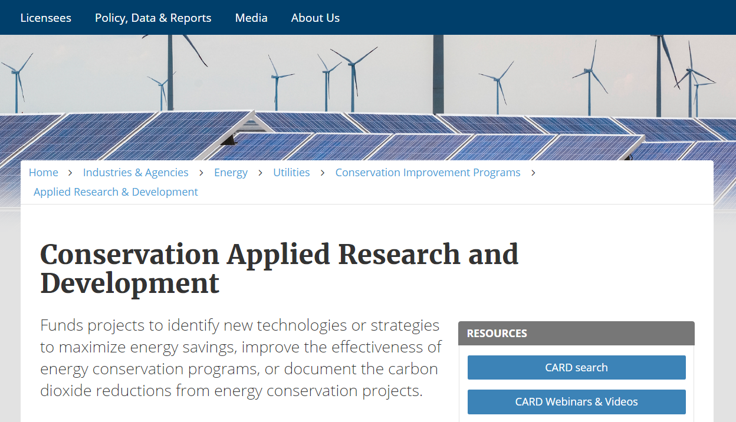
Division of Energy Resources
CARD Grant Funding

Slide 14
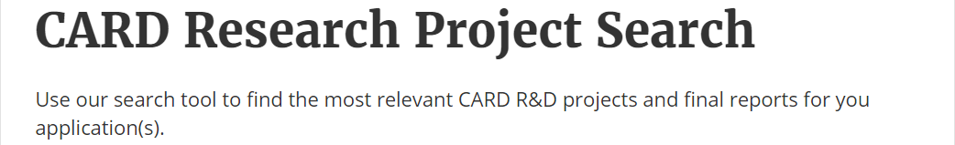
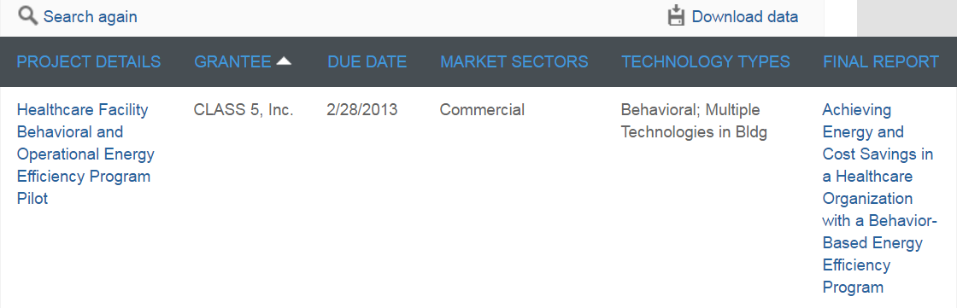
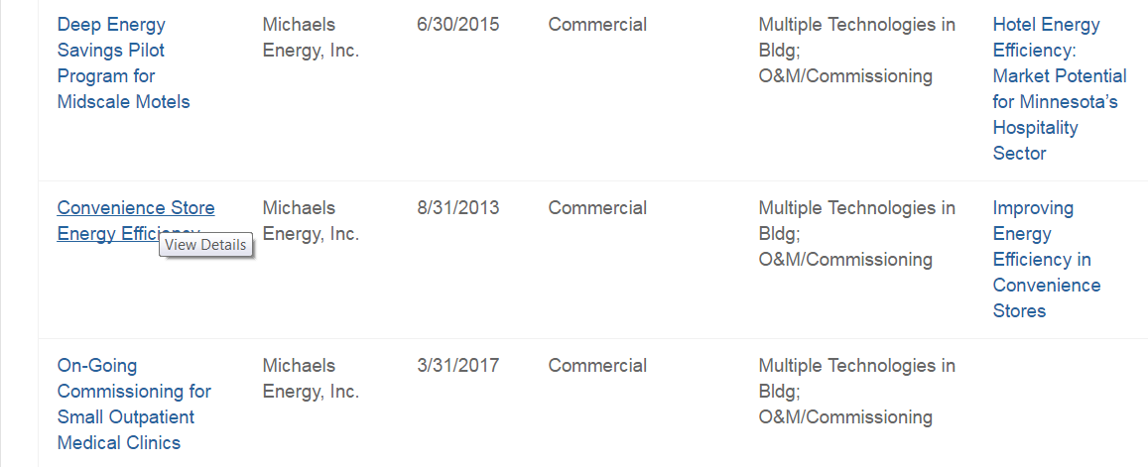
Division of Energy Resources
CARD Grant Study Example

Slide 15
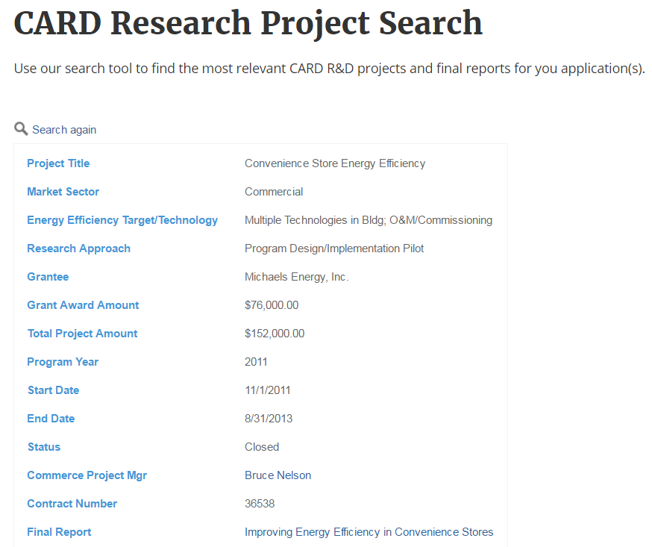
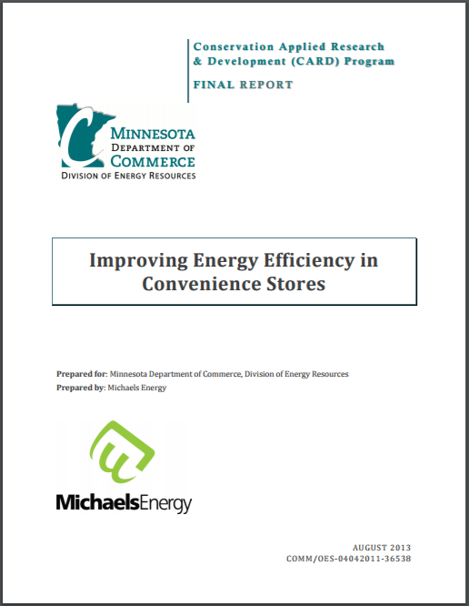
Division of Energy Resources
CARD Grant Study Example

Slide 16
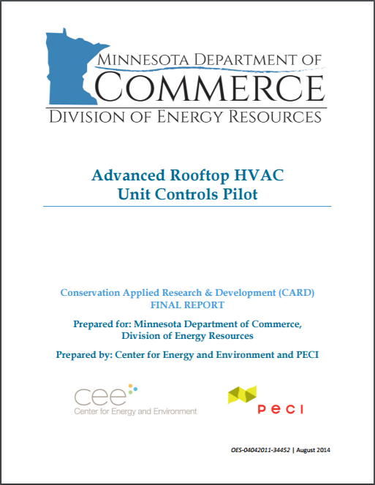
Division of Energy Resources
CARD Grant Study Example

Slide 17
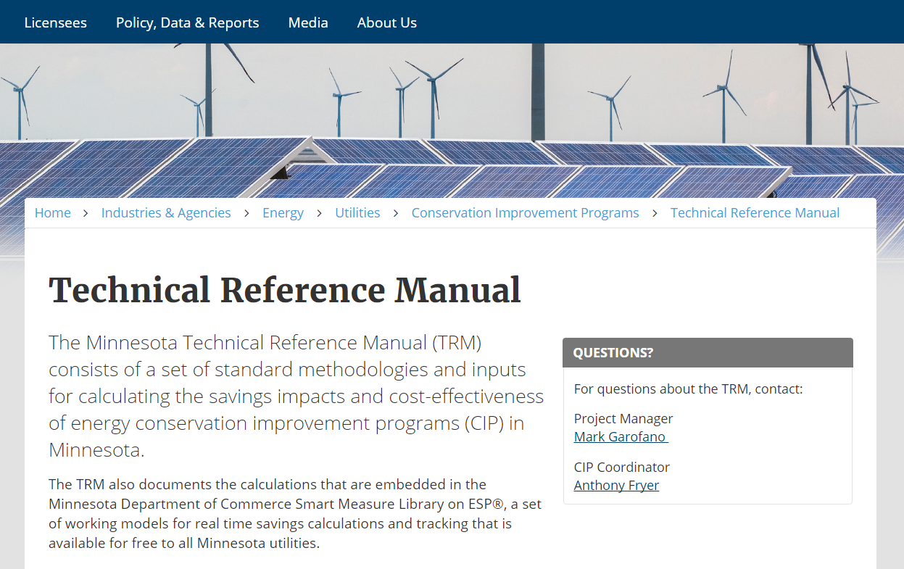
Division of Energy Resources
Technical Reference Manual

Slide 18
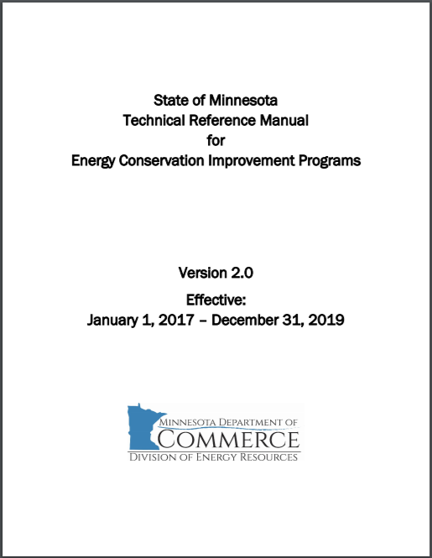
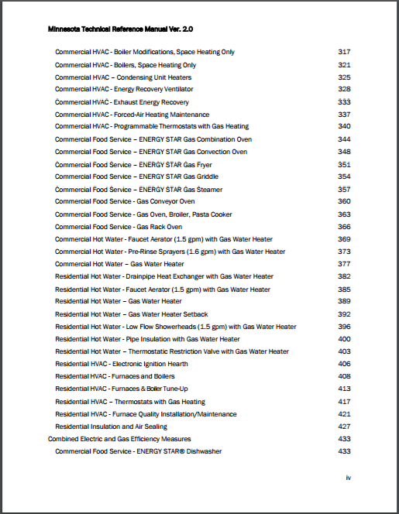
Division of Energy Resources
Technical Reference Manual

Slide 19
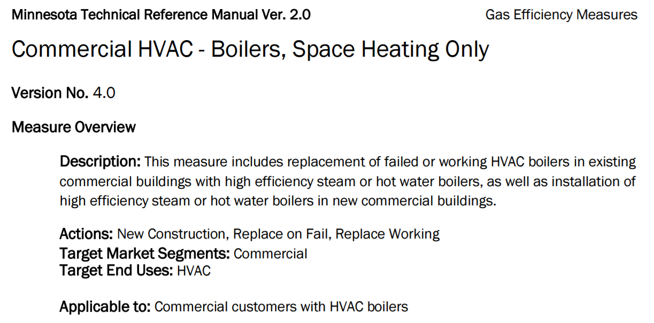
Division of Energy Resources
TRM 2.0 Boilers – Space Heating Only

Slide 20
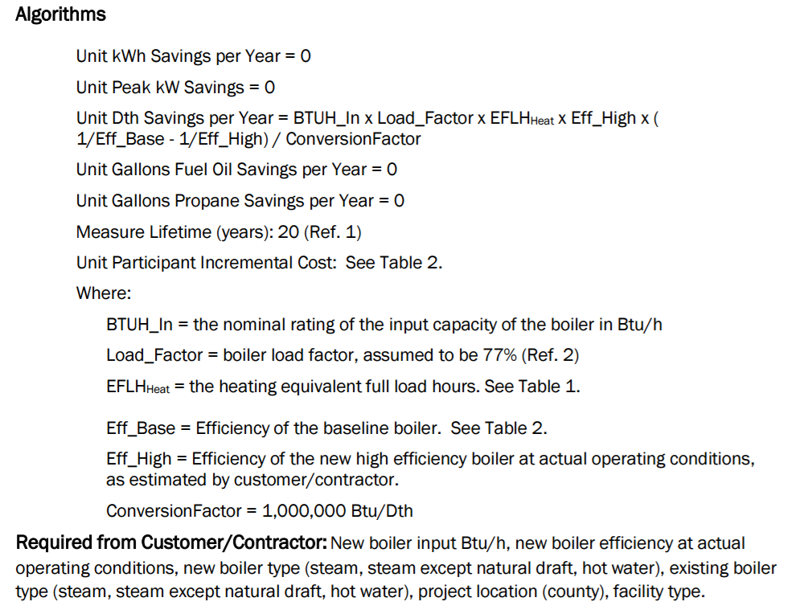
Division of Energy Resources
TRM 2.0 Boilers – Space Heating Only

Slide 21
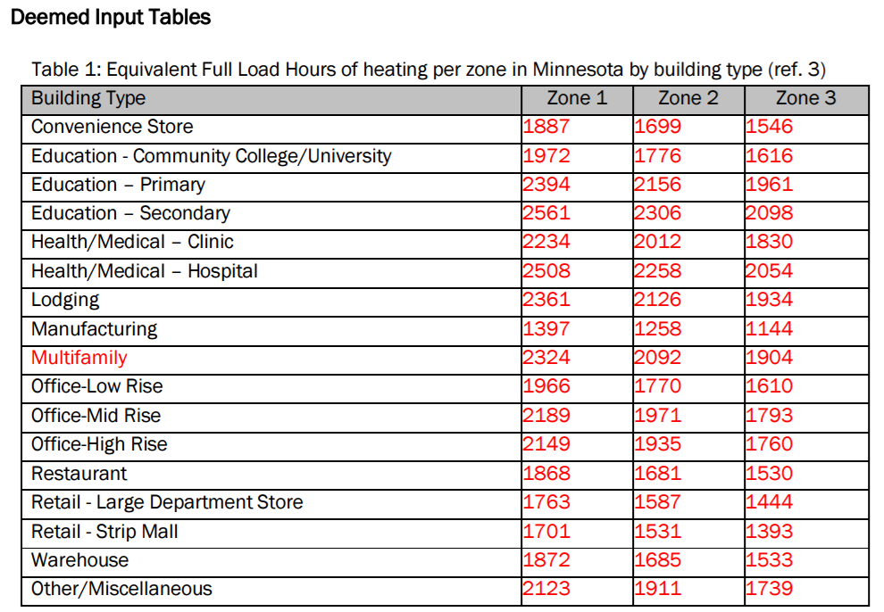
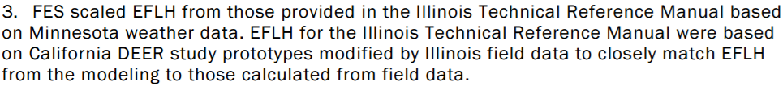
Division of Energy Resources
TRM 2.0 Boilers – Space Heating Only

Slide 22
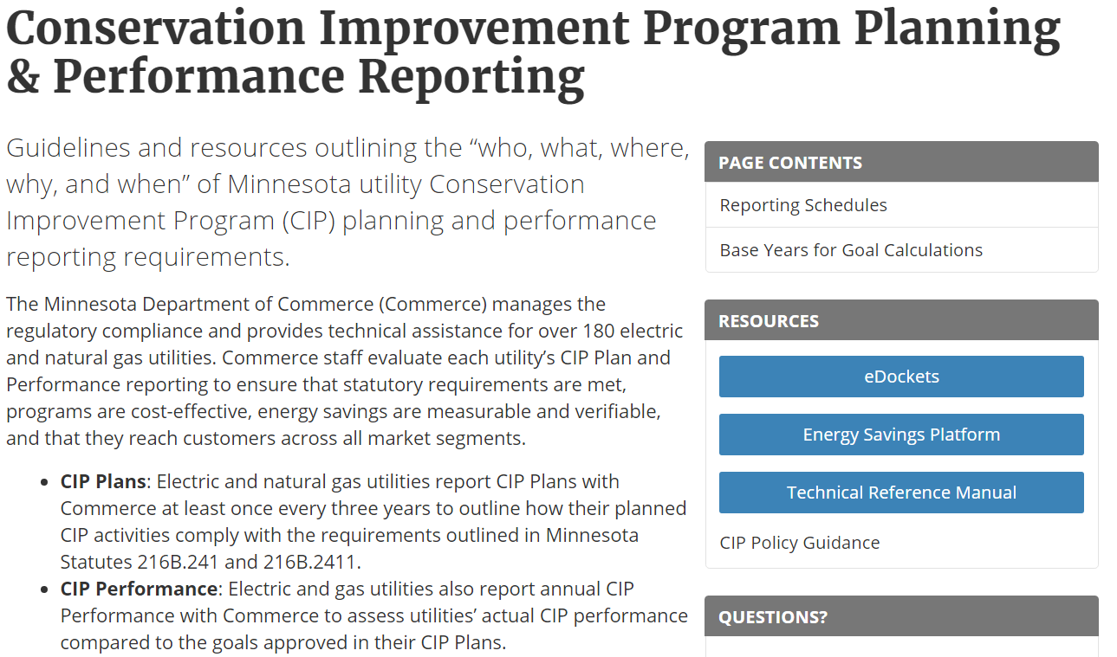
Division of Energy Resources
Energy Savings Platform (ESP)

Slide 23
Department of Commerce
Division of Energy Resources
A 2015 study on the economic impact of CIP (.pdf) found that every dollar invested in CIP provides $4 to $4.30 in energy savings, environmental benefits, and new economic activity.
Investments in energy efficiency improve the economy in two ways:
spending on energy efficiency projects supports jobs and business for contractors and suppliers directly involved in the projects, and
the money that consumers save from lower utility bills can be spent on other goods and services.

Slide 24
Conservation Improvement Program
Overview
Energy utilities in MN are required to promote and deliver energy efficiency programs for their customers (State legislation)
Regulated by the MN Department of Commerce (DOC), Division of Energy Resources (DER), and the MN Public Utilities Commission (PUC) to ensure:
  Ratepayer dollars are use effectively
  Annual energy savings and spending are reported accurately
MN is a national leader regarding energy efficiency and has been recognized by the American Council for an Energy-Efficient Economy (ACEEE), ranking as the 10th most energy efficient state in America during 2016.
Notes:
CenterPoint Energy's energy-saving programs and services for efficient natural gas equipment can lower your energy use and operating costs.​
CenterPoint Energy's natural gas equipment rebate program for businesses includes boilers, and boiler system components, boiler tune-ups, steam trap repair or replacement, other heating system rebates, water heater rebates, foodservice equipment rebates and more. Ask our experts for an energy analysis of your business and learn more about energy saving tips.
Learn more about CenterPoint Energy Efficiency rebate programs and services for your business at CenterPoint Energy.com/Business

Slide 25
2017 C & I Rebate Programs & Services
Agenda
Heating system rebates
Water heating rebates
Process equipment rebates
Foodservice equipment rebates
Custom rebates
Natural Gas Energy Analysis
Process Steam Trap Audit program
Multi-Family Building Efficiency program
Design / Engineering programs
Prescriptive Rebates
New rebate
Programs
Program is valid for 2017 calendar year installation
Notes:
CenterPoint Energy provides a variety of energy efficiency services to its commercial and industrial customers, ranging from training and education to in-depth support with identifying and implementing industrial process improvements.

Slide 26
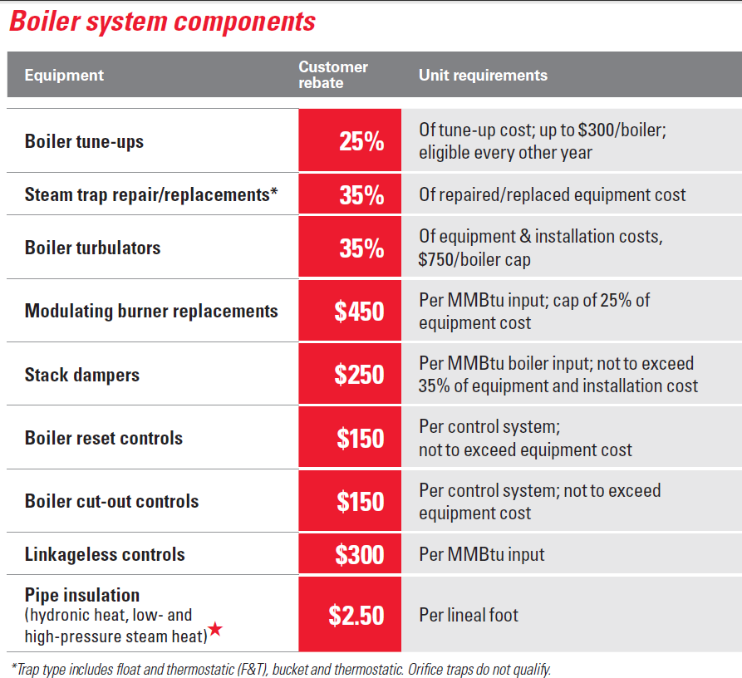
2017 C & I Rebate Programs & Services
Heating
(Retrofit only)
New rebate
Notes:
CenterPoint Energy provides a variety of energy efficiency services to its commercial and industrial customers, ranging from training and education to in-depth support with identifying and implementing new natural gas equipment.
Here you can see the Boiler rebates.

Slide 27
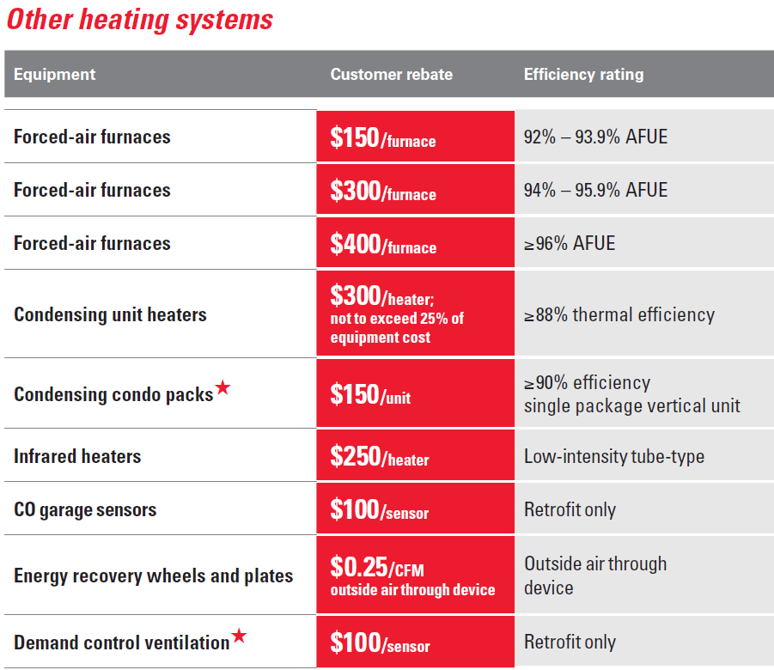
2017 C & I Rebate Programs & Services
Other Heating
New rebate
Notes:
In addition, we offer other heating system rebates shown here.

Slide 28
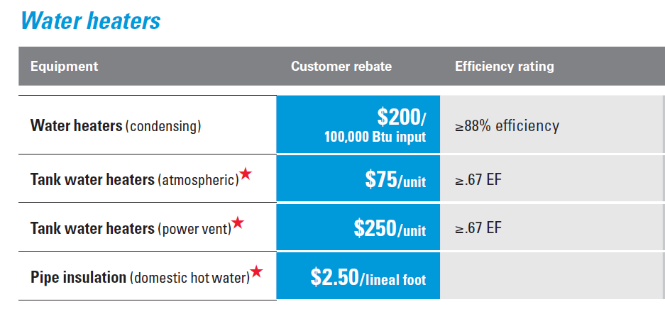
2017 C & I Rebate Programs & Services
Water Heating
New rebate
Notes:
Commercial water heating has three new rebates added for the 2017 program seen above.
In addition, trade ally incentives are available too.

Slide 29
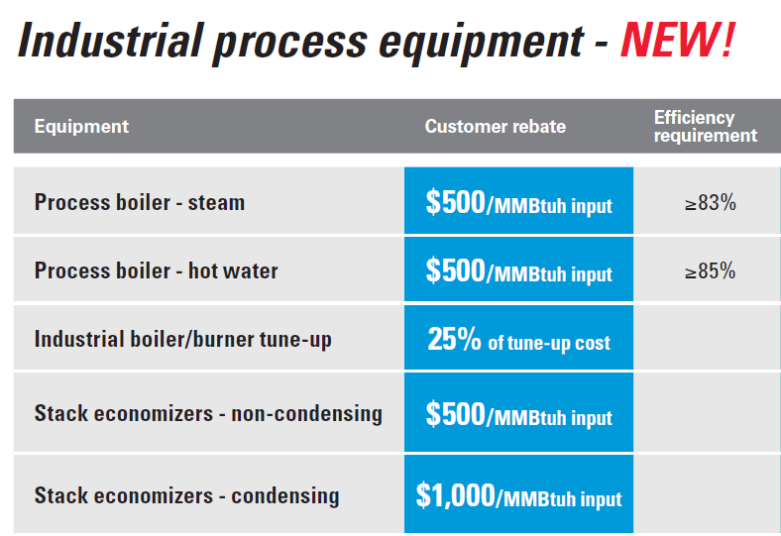
2017 C & I Rebate Programs & Services
Process Equipment
Notes:
CenterPoint Energy provides in-depth support with identifying and implementing industrial process improvements (natural gas equipment used for a process rather than heating).

Slide 30


2017 C & I Rebate Programs & Services
Foodservice Equipment Rebates
Equipment | Energy Efficiency |  | Rebate/unit
Booster water heaters |  |  | $750
Broilers infrared, upright |  |  | $600
Charbroilers infrared |  |  | $300
Combi ovens New! | FSTC | Energy Star® | $2,000
Combi ovens |  |  | $1,500
Convection ovens | FSTC | Energy Star® | $500
Conveyor ovens | FSTC |  | $750
Dishwashers natural gas heated |  |  | $1,200
Dishwashers with natural gas hot water source |  | Energy Star® | $125
Fryers Increased! ≥ 51% cooking energy efficiency | FSTC | Energy Star® | $750
Fryers Increased! 50% cooking energy efficiency | FSTC | Energy Star® | $500
Notes:
The Commercial Foodservice Equipment Rebates project will provide financial incentives for high efficiency natural gas foodservice equipment.
For the 2017 program there are 20 qualifying foodservice equipment rebates

Slide 31

2017 C & I Rebate Programs & Services
Foodservice Equipment Rebates
Equipment | Energy Efficiency |  | Rebate/unit
Griddles New! | FSTC | Energy Star® | $300
Kitchen hood demand control ventilation |  |  | $0.30/ Hood CFM
Pasta cookers |  |  | $200
Pre-rinse spray valves ≤ 1.28 GPM - natural gas hot water source |  |  | $15
Rotating rack ovens Increased! | FSTC | Energy Star® | $1,000
Rotisserie ovens infrared |  |  | $500
Salamander broilers infrared |  |  | $150
Steamers – compartment New! | FSTC | Energy Star® | $1,000
Steam equipment* |  |  | $250
*Ask about qualifying equipment
CenterPointEnergy.com/Foodservice
Notes:
More rebates equals more savings.
Whether your business is a school cafeteria,
office building, restaurant, healthcare or
another type of foodservice operation, we have
rebates that can help you reduce energy costs,
add efficiency and increase quality.
Learn more at CenterPoint Energy dot com slash foodservice

Slide 32
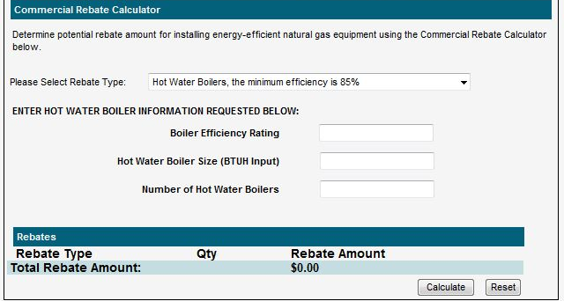
2017 C & I Rebate Programs & Services
Prescriptive Rebate Calculator
Estimate your rebate amount when you’re installing new or replacing old equipment using our Commercial Rebate Calculator
Simply select the equipment piece
Enter in required info
Find out the potential rebate
amount your customer will receive
CenterPointEnergy.com/RebateCalculator
Notes:
2/15/2017
32
The rebate calculator is a very useful tool when meeting with customers and works on laptops and smartphones.

Slide 33
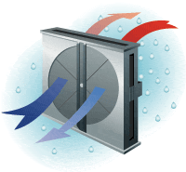
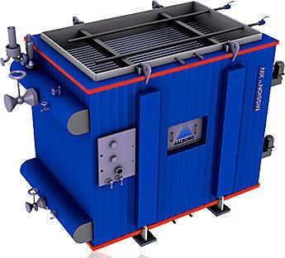
2017 C & I Rebate Programs & Services
Custom Rebates
What is the custom rebate program?
The custom rebate program is designed to provide rebate opportunities for natural gas saving technologies not covered in our Prescriptive rebate offerings.
For a project to be approved for a custom rebate:
Contact CenterPoint Energy early on in the idea or proposal stage to review the project.
Provide project scope, energy savings calculations and project costs.
CenterPointEnergy.com/MNCustom
Notes:
The custom rebate program is designed to provide rebate opportunities for natural gas saving technologies not covered in our Prescriptive rebate offerings.
Some custom rebate technologies include:
Energy recovery systems
Air destratification systems
Building envelope:
Roofs
Windows
Dust (particle) collector
Waste heat recovery
And more…
Learn more at CenterPoint Energy dot com slash M N Custom

Slide 34
2017 C & I Rebate Programs & Services
Natural Gas Energy Analysis
What is a Natural Gas Energy Analysis?
A certified energy auditor will visit your facility, inspect your building envelope and installed natural gas equipment, examine how it is operated, and identify opportunities to improve energy efficiency.
Type of analysis | Cost | Value
Basic (for small business) | $50 | $500
Comprehensive (for mid-size businesses) | $200 | $1,600
Custom (for larger operations) | Costs determined on a project-by-project basis for this specialized, in-depth approach.
Ad hoc services (for specific energy use analysis, such as steam trap surveys for heating system and infrared scans) | Costs determined on a project-by-project basis.
New for 2017! FREE direct install gas-saving measures include:
Programmable thermostats
Low-flow aerators & showerheads
Pre-rinse spray valves
Weather-stripping for exterior doors
CenterPointEnergy.com/EnergyAnalysis
Notes:
A Natural Gas Energy Analysis can help cut costs for businesses of any size*.A certified energy auditor will visit the facility, inspect the building envelope and install natural gas equipment.
The auditor will also examine how the equipment is operating and identify opportunities to improve efficiency and potentially qualify for a rebate.All analyses receive a detailed report with specific recommendations to help develop an energy savings plan.
New for 2017! Participants are also eligible for free direct install gas-saving measures including programmable thermostats, low-flow aerators and showerheads, pre-rinse spray valves and weatherstripping for exterior doors.

Slide 35
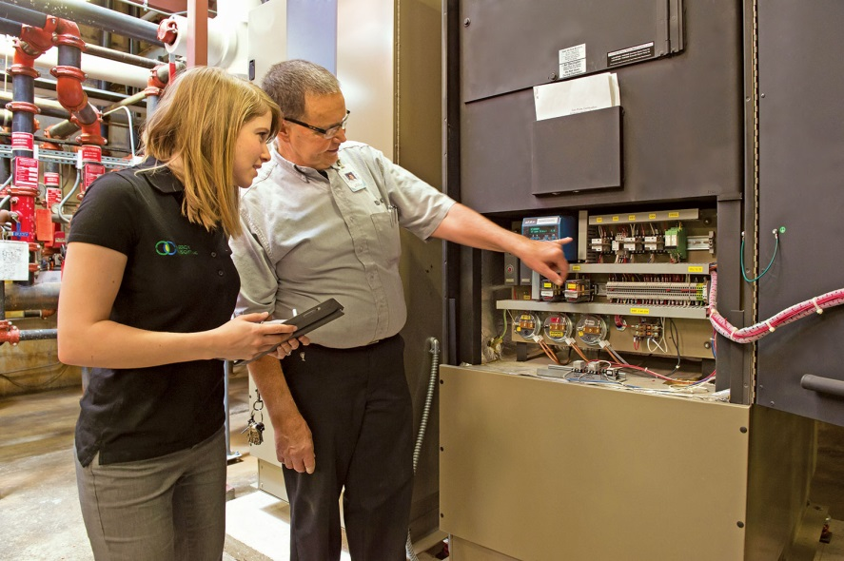
2017 C & I Rebate Programs & Services
Natural Gas Energy Analysis
What’s covered in the Analysis?
Building Envelope
HVAC
Controls
Kitchen and Laundry Equipment
Water Heaters
  For full details visit CenterPointEnergy.com/EnergyAnalysis
Notes:
2/15/2017
35

Slide 36
2017 C & I Rebate Programs & Services
Process Steam Trap Audit Program
How the Process Steam Trap Audit program works:
• Customers may participate in the program every other year.
• The program pays for the steam trap audit at a rate of $15/tested trap up to 100% of the audit’s cost.
Audit funding is payable upon receipt of:
• Program application
• Audit log sheet(s)
• Invoices(s) for repaired trap(s)
• Invoice for the audit
• Invoices(s) for the repair labor (or estimate for internal labor)
CenterPointEnergy.com/ProcessSteamTrapAudit
Notes:
distribution system can help increase its efficiency by identifying steam traps in need of replacement or repair.
Customers will enjoy rapid payback when they combine eligible audit rebates with qualifying equipment rebates provided through our Custom Rebate Program.Additional custom rebates are subject to engineering and payback criteria analysis for qualifications.
How the Process Steam Trap Audit program works:
• Customers may participate in the program every other year.
• The program pays for the steam trap audit at a rate of $15/tested trap up to 100% of the audit’s cost.
Audit funding is payable upon receipt of:
• Program application
• Audit log sheet(s)
• Invoices(s) for repaired trap(s)
• Invoice for the audit
• Invoices(s) for the repair labor (or estimate for internal labor)
For more details, CenterPointEnergy.com/ProcessSteamTrapAudit

Slide 37
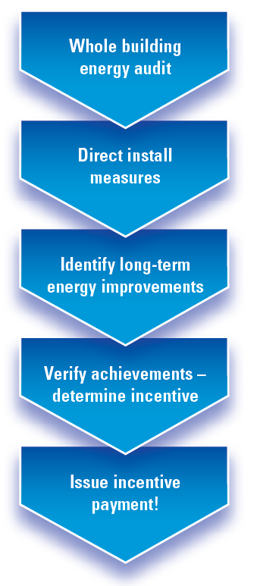
2017 C & I Rebate Programs & Services
Multi-Family Building Efficiency
  Joint offering between CenterPoint Energy and Xcel Energy
  Helps property owners understand their buildings' energy
  use
  Goal: achieve immediate energy savings through low
  cost/no cost improvements and move beyond initial
  measures to achieve deeper savings
  Visit MultiFamilyEnergySolutions.com
Achievement | Whole-building energy savings | Incentive level
Tier 1 | 15% | 25% of cost
Tier 2 | 20% | 35% of cost
Tier 3 | 25% | 40% of cost
Notes:
1. Starts with a free audit looking at whole building improvement potentials from lighting to heating and coloring systems, insulation, and other equipment areas that could benefit from efficiency measures
2. Next comes the free installs- LED lights in common areas, showerheads, water heater blankets, CFL lights in rental units, faucet aerators, and LEDs in exit signs
3. Implementation support- for other improvement efforts requiring engineering, retrofitting, or equipment, the program offers consulting support
4. Before and after comparison- a report of building’s energy consumption before and after addressing the improvements
5. Educate tenants and staff
6. Incentives paid out upon completion of all energy-saving measures

Slide 38
2017 C & I Rebate Programs & Services
Affordable Housing Multi-Family Rebate Program
If you’re working with a customer offering affordable housing multi-family, they can receive a 25% rebate bonus in addition to the prescriptive rebate amount
Eligibility:
Five or more housing units in the building
Minimum of 66% of units occupied by low-income households
  For full details visit CenterPointEnergy.com/AffordableHousingMultiFamily

Slide 39

2017 C & I Rebate Programs & Services
Design / Engineering Programs
Engineering and Certification Assistance
  Engineering Assistance
  LEED Certification
  ENERY STAR ® Verification Assistance Program
Energy Design Assistance
Recommissioning
Process Efficiency

Slide 40
2017 C & I Rebate Programs & Services
Design / Engineering Programs
Engineering and Certification Assistance
This program helps customers cover the cost of identifying, implementing and receiving third-party certification for energy efficiency upgrades. It also provides support for customers seeking ENERGY STAR® certification for their buildings.
Engineering Assistance Program | LEED Certification Assistance Program | ENERGY STAR® Verification Assistance Program
Provides funding UP to $5,000 $5,000 additional if qualifying natural gas technologies are installed | Reimburses customers UP to $5,000 $5,000 additional following the completion and submission of application | Reimburse customers for the cost of the ENERGY STAR® application verification UP to $1,500 per building
CenterPointEnergy.com/EngineeringPrograms
Notes:
Engineering and Certification Assistance
This program helps customers cover the cost of identifying, implementing and receiving third-party certification for energy efficiency upgrades.It also provides support for customers seeking ENERGY STAR® certification for their buildings.
Engineering Assistance Program
Provides funding up to $5,000 to commercial and industrial customers for a portion of engineering fees for study, design and installation of qualifying energy-efficiency projects.Customers may be eligible for up to an additional $5,000 if qualifying natural gas technologies are installed.Pre-approval of the study and funding are required prior to starting.
LEED Certification Assistance Program
Reimburses customers up to $5,000 for a portion of the cost of analysis, documentation and other costs associated with submission of LEED assistance.Customers may also be eligible for up to an additional $5,000 following the completion and submission of the application.Pre-approval of the application is required.
ENERGY STAR® Verification Assistance Program
Requires that a building’s application be verified by a registered professional engineer or architect.CenterPoint Energy will reimburse customers for the cost of the ENERGY STAR® application verification up to a maximum of $1,500 per building.Customer must provide a copy of the verified application and documentation of the verification costs.
CenterPoint Energy offers a variety of design/engineering programs.If your customers are considering making energy efficiency design improvements to their facilities, contact your trade ally representative, one of our energy efficiency engineers or call 612-321-4330 (800-234-5800 ext.4330).
Engineering and Certification Assistance
This program helps customers cover the cost of identifying, implementing and receiving third-party certification for energy efficiency upgrades.It also provides support for customers seeking ENERGY STAR® certification for their buildings.
Engineering Assistance Program
Provides funding up to $5,000 to commercial and industrial customers for a portion of engineering fees for study, design and installation of qualifying energy-efficiency projects.Customers may be eligible for an up to additional $5,000 if qualifying natural gas technologies are installed.Pre-approval of the study and funding are required prior to starting.
LEED Certification Assistance Program
Reimburses customers up to $5,000 for a portion of the cost of analysis, documentation and other costs associated with submission of LEED assistance.Customers may also be eligible for an additional $5,000 following the completion and submission of the application.Pre-approval of the application is required.
ENERGY STAR® Verification Assistance Program
Requires that a building’s application be verified by a registered professional engineer or architect.CenterPoint Energy will reimburse customers for the cost of the ENERGY STAR® application verification up to a maximum of $1,500 per building.Customer must provide a copy of the verified application and documentation of the verification costs.

Slide 41
2017 C & I Rebate Programs & Services
Energy Design Assistance
Energy Design Assistance (EDA)
A free, comprehensive approach to energy savings
for our customer’s planned building that includes:
Energy modeling
Predicted energy use
Strategies for energy savings
Projected energy cost savings for those strategies
Notes:
Energy Design Assistance (EDA)
This program encourages building owners, architects and engineers to design maximum energy efficiency into their new construction and major renovation projects.This program provides building design consulting services, provided by our third-party energy modeling firm, at no cost to participating customers, and CenterPoint Energy offers a rebate for projects that realize over 5 percent energy savings. The program is offered collaboratively with the customer’s electric utility, subject to availability.

Slide 42
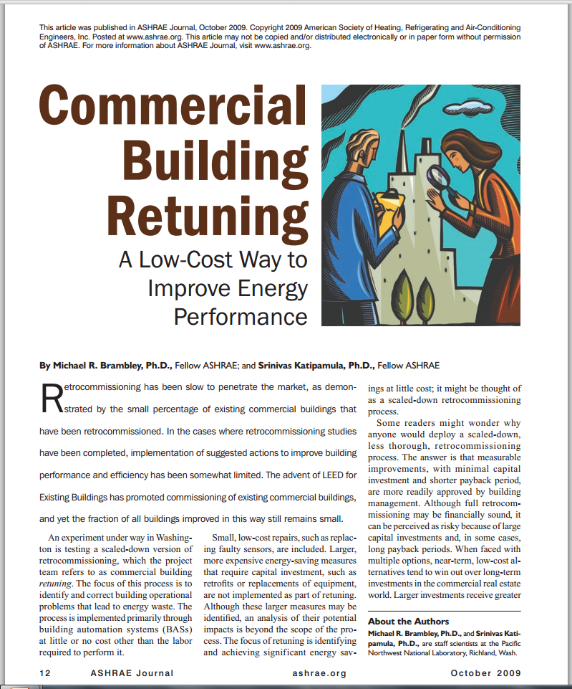
2017 C & I Rebate Programs & Services
Recommissioning
Recommissioning:
Identifying and implementing low-cost “tune-up” improvements to functional systems in a customer’s existing facility that allow it run as efficiently as possible.
Diagnosis: Recommissioning study
Implementation
ASHRAE Journal October 2009

Slide 43

2017 C & I Rebate Programs & Services
Recommissioning
Investigation results in a Study Report reviewed by CenterPoint Energy, including:
Building and equipment description
Operational observations
Calculations
CenterPoint has authorization from Xcel to receive a copy of the completed “Tool” for calculations.

Slide 44
2017 C & I Rebate Programs & Services
Process Efficiency
What is the Process Efficiency program?
The Process Efficiency program is designed to provide funding for an energy efficiency study to identify, scope, and ultimately lead to the implementation of energy-saving opportunities.
The project will be delivered in three phases:
Phase 1 - Identification: A high-level analysis will be conducted to identify the energy conservation potential of the facility. This is completed at no cost to the customer.
Phase 2 - Scoping: CenterPoint Energy will provide additional support and resources to define and provide recommendations for energy-saving opportunities.
Phase 3 – Implementation: CenterPoint Energy will work with the customer to put in place a schedule with energy-saving goals and cost-savings estimates. Measures implemented as a result of this schedule will be eligible for CIP rebates to offset the cost of the facility upgrades.
Notes:
The Process Efficiency program is designed to provide funding for an energy efficiency study to identify, scope, and ultimately lead to the implementation of energy-saving opportunities. This project approaches each facility as a system, taking advantage of all applicable conservation improvement projects in addition to providing financial support for comprehensive studies.
Rebates
Rebates offered during the Industrial Process Efficiency project will include prescriptive measures as well as custom rebates offered through CenterPoint Energy’s commercial and industrial CIP offerings. Thec ommercial and industrial rebates will be implemented as approved in the applicable CIP project.
The Industrial Process Efficiency project will utilize the rebate structure of existing CIP projects and will also incorporate additional rebate bonuses for system optimization and/or exceeding annual achievement targets.

Slide 45

2017 C & I Rebate Programs & Services
Process Efficiency
Graphet, Inc. Overview
Objective, fact-based solutions provider
Expertise for sustainable energy conservation
Vendor-neutral
190+ energy diagnostic sessions conducted
http://www.graphet.com/

Slide 46
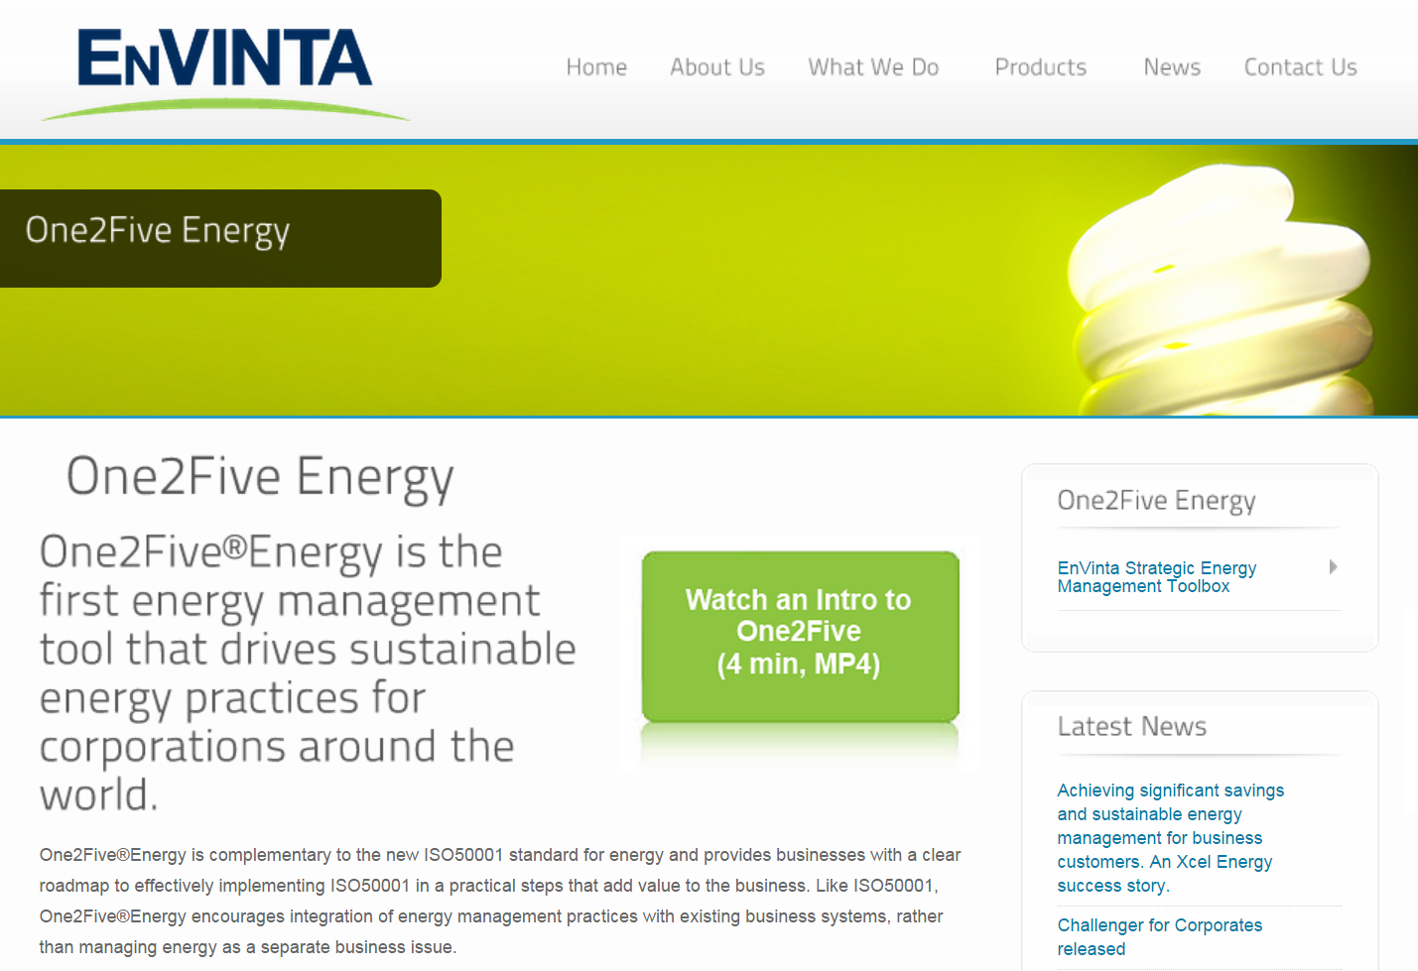
2017 C & I Rebate Programs & Services
Process Efficiency
For more information visit http://www.envinta.com

Slide 47
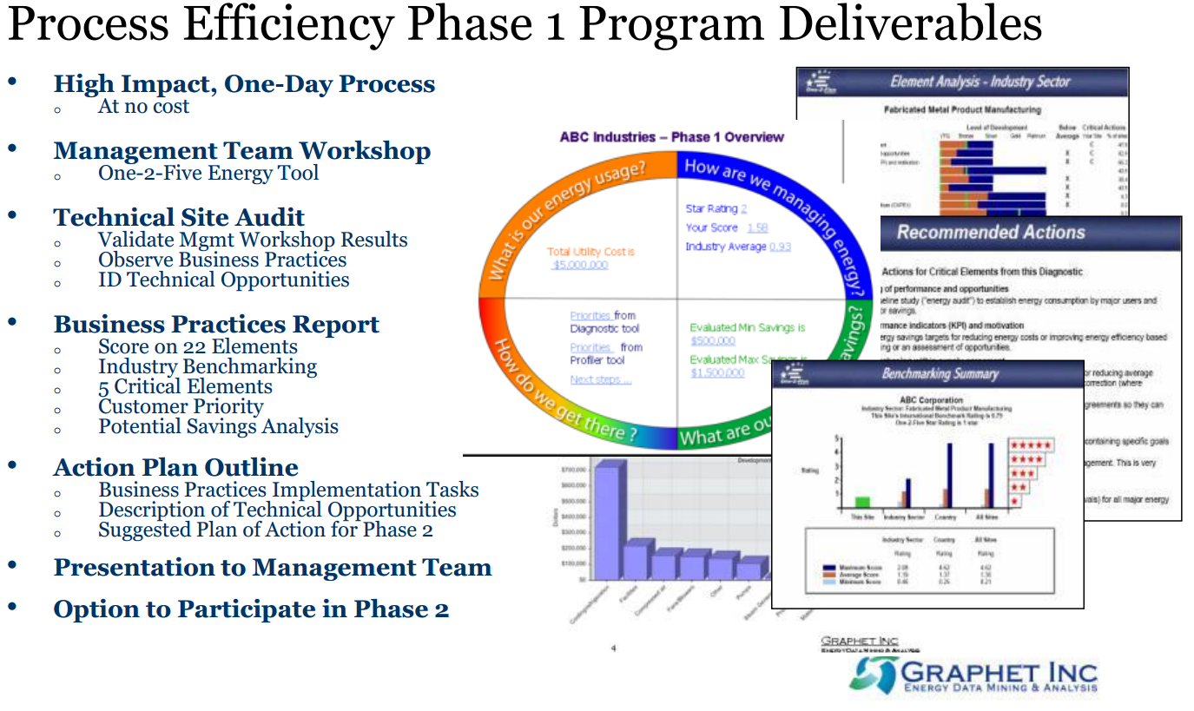
2017 C & I Rebate Programs & Services
Process Efficiency

Slide 48




Contact Info
Trade Ally Representative
Dave Poretti
612-321-4386
David.Poretti@CenterPointEnergy.com
Technical Sales Engineers
Brent Casmey
612-321-4342
Brent.Casmey@CenterPointEnergy.com
Eric Johansen
612-321-4357
Eric.Johansen@CenterPointEnergy.com
Nick VanDuzee
612-321-4336
Nicholas.VanDuzee@CenterPointEnergy.com
Notes:
If you would like one of our engineers to help you think through an equipment decision, please feel free to contact any of the above or start with David Poretti and he will get you connected to the appropriate engineer for your market.

Slide 49
Questions?
Thank You!

