Slide 1

2017 Business Program Update for AEE
February 16, 2017
Jeff Jackson, Trade Relations Manager

Slide 2
Agenda
Triennial Overview
Program Updates
Digital Applications
Resources

Slide 3
Triennial Overview
Xcel Energy files a triennial plan with the DER every 3 years. This year is the beginning of our new 2017-2019 triennial
  This plan determines which programs will be offered for the upcoming years.
  Updates goals, saving, and rebates to reflect current Energy Code and industry standards.
Programs are funded by ratepayer dollars, which are accrued from customer bills as part of the “Resource Adjustment” rider on a customer’s bill.
Solar and Wind programs are funded through a separate budget.

Slide 4
Triennial Overview
Prescriptive
  Lighting Efficiency
  Cooling Efficiency
  Heating Efficiency
  Motors & Drives Efficiency
  Foodservice Equipment
  Fluid Systems Optimization
  Computer Efficiency
Custom
  Custom Efficiency
  Efficiency Controls
Study/Holistic
  Business New Construction
    Energy Design Assistance
    Energy Efficient Buildings
  Recommissioning
  Turn Key Services
  Fluid Systems Optimization
  Data Center Efficiency
  Process Efficiency
  Commercial Efficiency
*programs in bolded red have changed

Slide 5
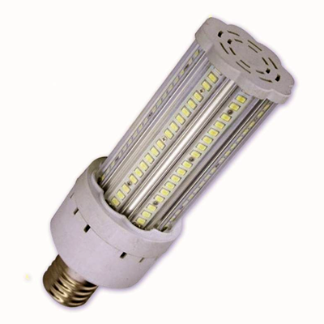
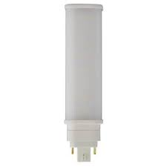
C&I Lighting - 2017
Changes for invoice dates on or after Jan 1, 2017
  Rebate categories going away
    HID (MH, CMH, PSMH, HPS)
  New rebate categories
    LED HID Screw-In Replacements
    LED Four Pin-Based Replacement Lamps for CFL
    LED Downlights w/ FL baseline (as opposed to INC)
    Integral sensors for LED parking garage, troffers and case lighting
  New rebate tiers (within existing categories)
    LED Area Lights (141W – 199W; 200W – 550W)
    LED Parking Garage (61W – 83W)

Slide 6
C&I Lighting - 2017
Changes for invoice dates on or after Jan 1, 2017 (cont.)
  Rebate levels going down
    All Fluorescent Fixtures
    LED Case Lighting
    LED Canopy Fixtures
  Rebate levels going up
    LED Street Lighting
    LED Area Lighting
    LED Stairwell Fixture w/ integral sensor

Slide 7
C&I Lighting - 2017
  Potential new prescriptive products (Timing TBD)
    LED High Bay (w/ FL baseline)
    LED Ambient (strip lights)
    LED Open Case Lighting
  Advanced Lighting Controls Update
    Interior occupancy sensors and photocells are prescriptive
    Exterior occupancy sensors and photocells are a custom rebate
    Advanced Lighting Controls are a custom rebate

Slide 8
Efficiency Controls
Rebates have increased by 50%!!
  Electric rebates - $600/kw
  Gas rebates - $7.50/dth
  Any invoice dated after January 1, 2017 will qualify for the increased rebates even if pre-approved in 2016

Slide 9
Data Center Design Assistance – New Program
For customers adding at least 1 MW of IT load.
New construction and renovations
Consulting is free
$400/kW + $0.04/kWh (need to save 5% over the baseline to get rebate)
Design team incentives up to $6,000

Slide 10
Building Operator Certification (BOC)
What: BOC is a nationally recognized training and certification program offered by the Midwest Energy Efficiency Alliance (MEEA).
How: To become certified, building operators will complete 74 hours of classroom time in addition to 5 on-the-job projects. Xcel Energy will then claim deemed energy savings for the on-the-job projects and pay tuition reimbursement of $500 flat for those who complete the training.
Who: This offering will be available all customers of 50K sq ft and above in Xcel Energy Minnesota Service territory. Only one building operator per building may receive the tuition reimbursement.
Where: BOC trainings will be offered throughout our service territory and be scheduled and facilitated through MEEA.

Slide 11
Motors & Drives
No change to Rebates for VFDs or Motors for the 2017 – 2019 triennial
As of January 1, 2017
900 RPM is prescriptive for all motors and VFD measures

Slide 12
Cooling Efficiency
Codes increased and had to make changes
  Base efficiencies have increased
Invoice date determines what rebate they qualify for
Rebates based off SEER and IEER
  Rebates are not necessarily smaller
  Some lower efficiency equipment may not qualify anymore
Mini-split heat pumps now prescriptive
Cooling only mini splits – prescriptive rebate for data centers only

Slide 13
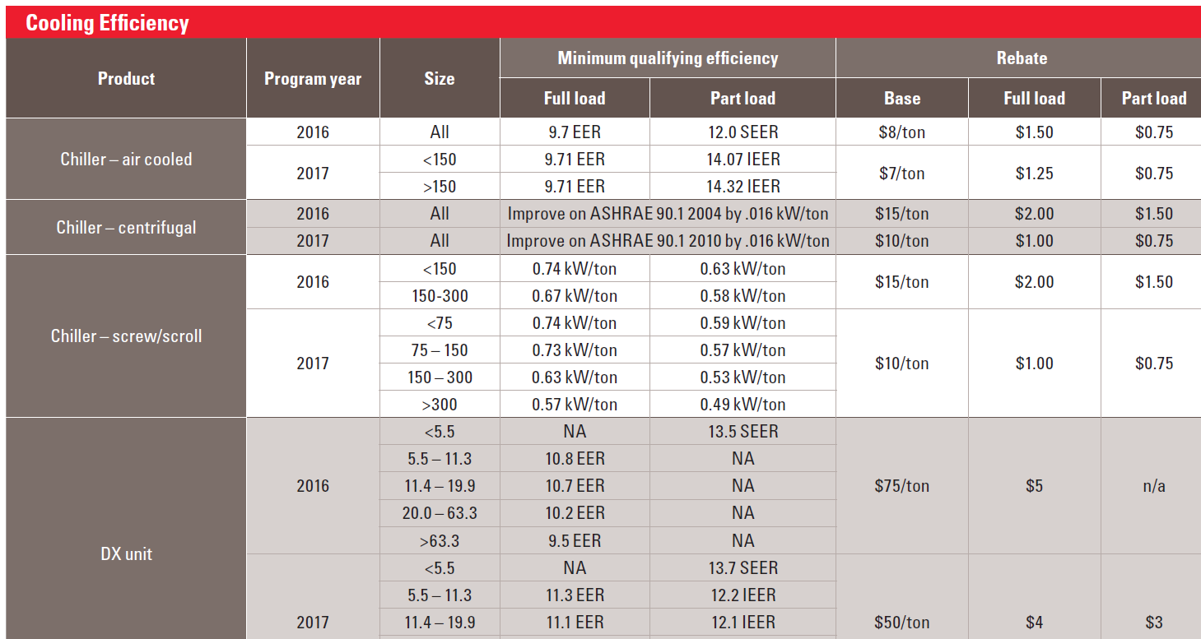
Cooling rebate changes

Slide 14
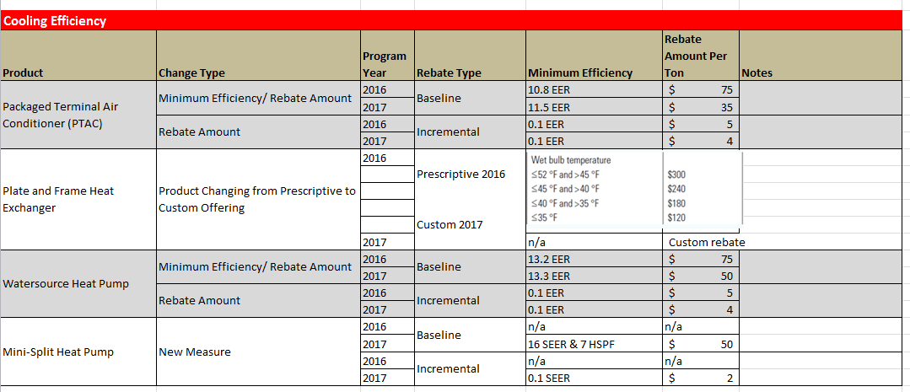
Cooling rebate changes

Slide 15
Mini split systems
Not the same as split systems
Split system – has one outside unit, one heat exchanger (evaporator) centrally located and ductwork to deliver the conditioned air
Mini-split systems – has refrigerant being delivered to the mounted units in individual zone (so typically no ductwork). There can also be many evaporator coils which make the incremental cost higher (each system can have a different number of coils)
Mini-splits – from a cost effectiveness standpoint the systems are poor for normal residential size ranges. The larger commercial systems do get into variable refrigerant flow types and the energy savings are difficult to calculate
Cooling only mini-splits will be available for data centers, all other applications do not have enough equivalent full load hours (pending regulatory approval)
Mini-split heat pumps (heating & cooling) will be available for all applications

Slide 16
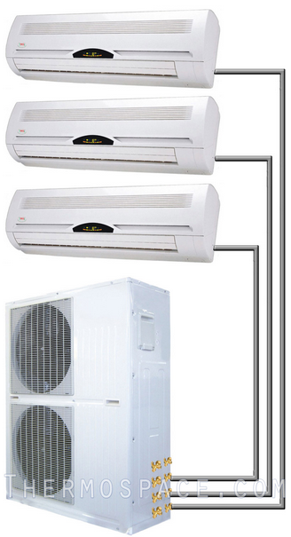
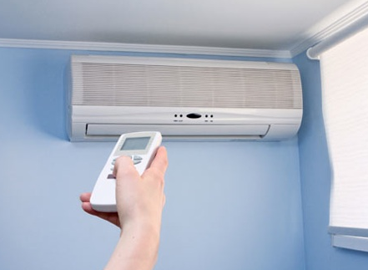
Mini-splits
Rebate Levels & Requirements | Baseline Rebate |  | Incremental Rebate
 | BaselineNew Rebateefficiency | New Base rebate per ton | Incremental RebateNew Increment | New Incr. rebate per ton
Mini-split heat pumps | 16 SEER & 7 HSPF | $50 | 0.1 SEER | $2
Cooling only Mini-splits (for data-centers) | 16 SEER | $50 | 0.1 SEER | $2

Slide 17
Heating Efficiency
Pipe Insulation
  No longer using R-Value
  Pipe Diameter * Linear Feet * Rebate Value = Total Rebate

Slide 18
Digital Applications
5-10 minutes to complete an application
Currently available for prescriptive and custom type projects
PDF versions of applications will continue to be supported
Can be accessed at via the various program pages or the direct link:
https://www.xcelenergy.com/digital_application

Slide 19
Getting Help With Projects
Trade Partners Website
www.xcelenergy.com/TradePartners
Energy Efficiency Specialists
  855-839-8862
Trade Relations Managers
  Jeff Jackson 612-330-7749
  jeffrey.s.jackson@xcelenergy.com
  Pat Berger 612-330-6213 patrick.j.berger@xcelenergy.com

Slide 20
Key Takeaways
Invoice date used to determine actual rebate given
Lighting progressing from HID, Fluorescent to LED
In general AC rebates are lower, but can be equivalent
Digital applications are available!

Slide 21
Thank you for your time!
Questions?

