Slide 1
AEE Utility Rebates –
Great River Energy
Jill Eide, Key Account Executive
February 16th, 2017

Slide 2
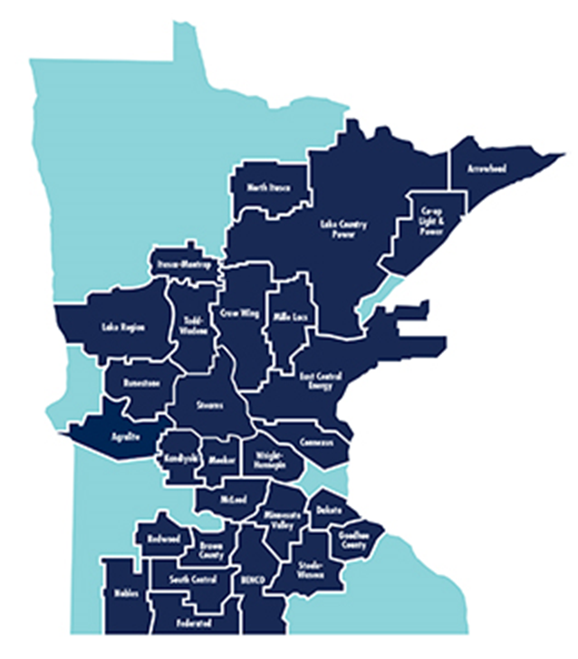
Who is Great River Energy?
Minnesota’s largest G&T cooperative electric utility
28 member-owner distribution cooperatives
665,000 services (about 1.7M people)
2,800 MW of generation

Slide 3
CI&A Programs
GRE aggregates programs to 28 member distribution cooperatives
Each distribution cooperative chooses which programs to offer to their member consumers

Slide 4
CI&A Rebate Programs
Lighting
  New Construction
  Retrofit
  Custom
HVAC
  RTUs, Split Systems, ASHPs, Economizers
  Tune-Ups
  PTAC, Mini-Splits, WSHPs
  GSHPs
  Chillers
Building Studies
  Energy Audit
  Engineering & Design Assistance
  Energy Star Certification
  Plan Review
  RCx
  Compressed Air Audit
Motors & Drives
  Premium Eff motor retros
  VFD / VSD
  Fractional HP motors & ECMs

Slide 5
CI&A Rebate Programs
Agricultural
  Dairy Free Heater
  Dairy Plate cooler
  Hog Farrowing
  Irrigator VFD
  Robotic Milking
  Barn ventilation
Forklifts
Food Service
  Hot food holding cabinets
  Ovens, cooktops & griddles
  Electric fryers
  Electric steamers
  Vending Machine control
  Dishwashers
  Ice Machines
  Refrigerators/Freezers

Slide 6
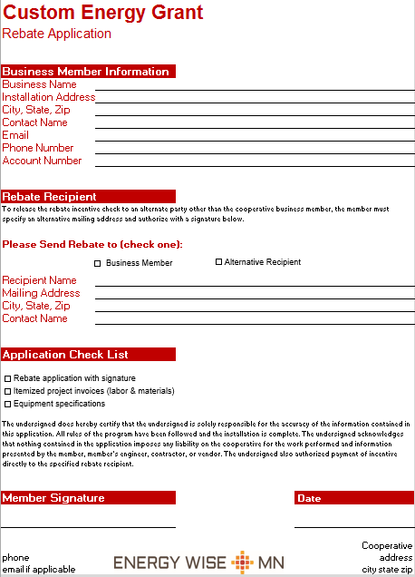
CI&A Rebate Programs
Custom
  Building automation
  Manufacturing processes
  Process improvements
  New technology

Slide 7
CI&A Load Management Programs
Rebate or Rate Incentives
  Interruptible Gen Sets
  Cycled Air Conditioning (up to 7.5ton units)
  Dual Fuel space heating
  Electric Thermal Storage (ETS) or Interruptible space and water heating

Slide 8
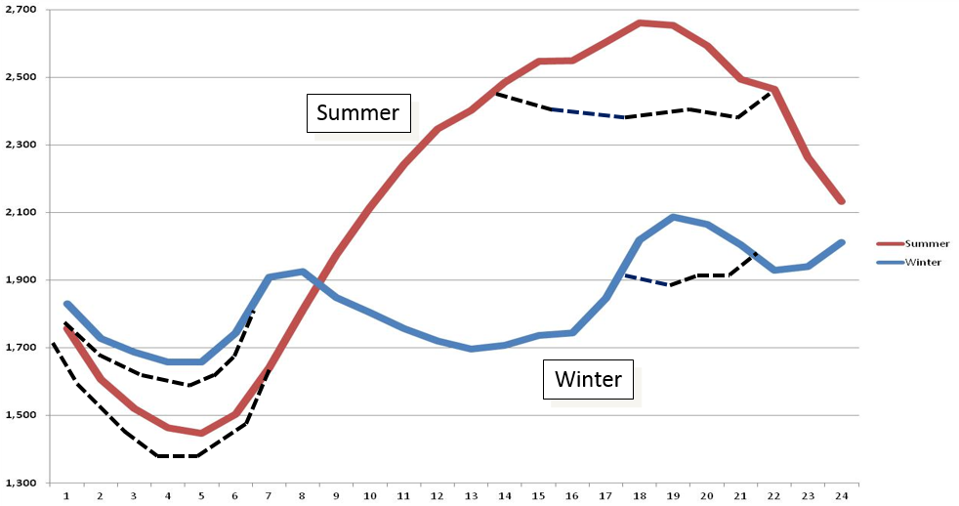
CI&A Load Management Programs

Slide 9
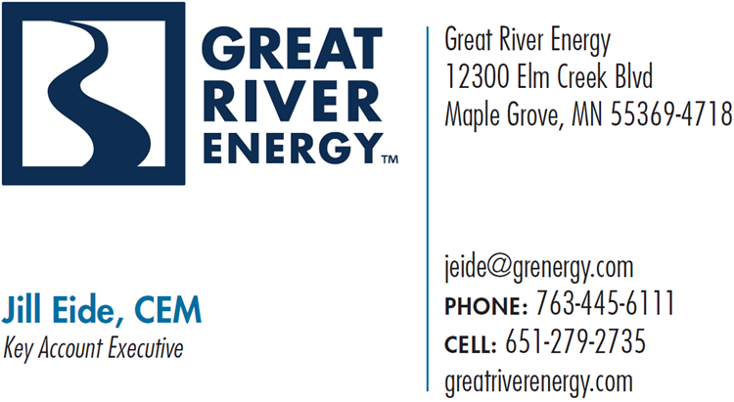
Questions/Comments/Concerns

